Slide 1
Holistic Evaluation of Reservoir Oil Viscosity in Breidablikk Field – Including Mud Gas Logging Approach - SPWLA-2023-0039 Alexandra Cely, Ingvar Skaar and Tao Yang Equinor ASA
Norwegian Formation Evaluation Society
Monthly Meeting @ Solastranden Gård, Sola
7th February 2024
Sponsors

Slide 2
Outline
Background
Available technologies for Reservoir oil viscosity estimation
Breidablikk Field Description
Reservoir Oil viscosity estimation from mud gas logging:
Standard Mud Gas
Advanced Mud Gas
Reservoir Oil viscosity estimation from Cuttings Analysis
Conclusions

Slide 3
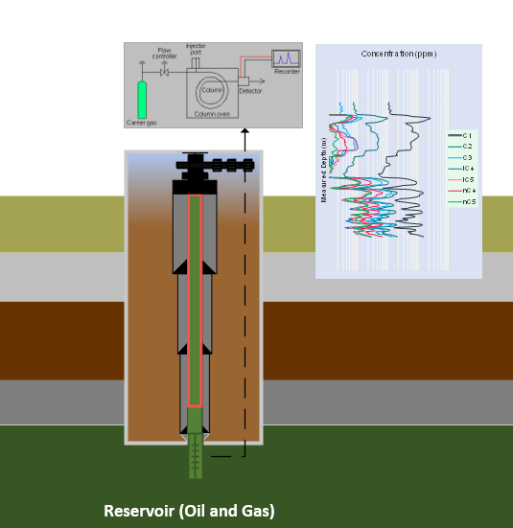
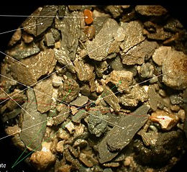
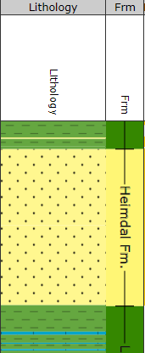
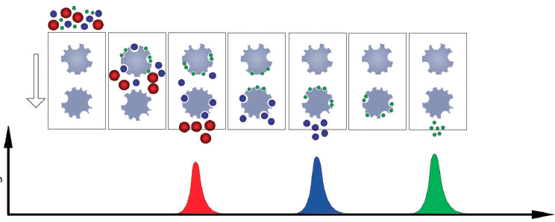
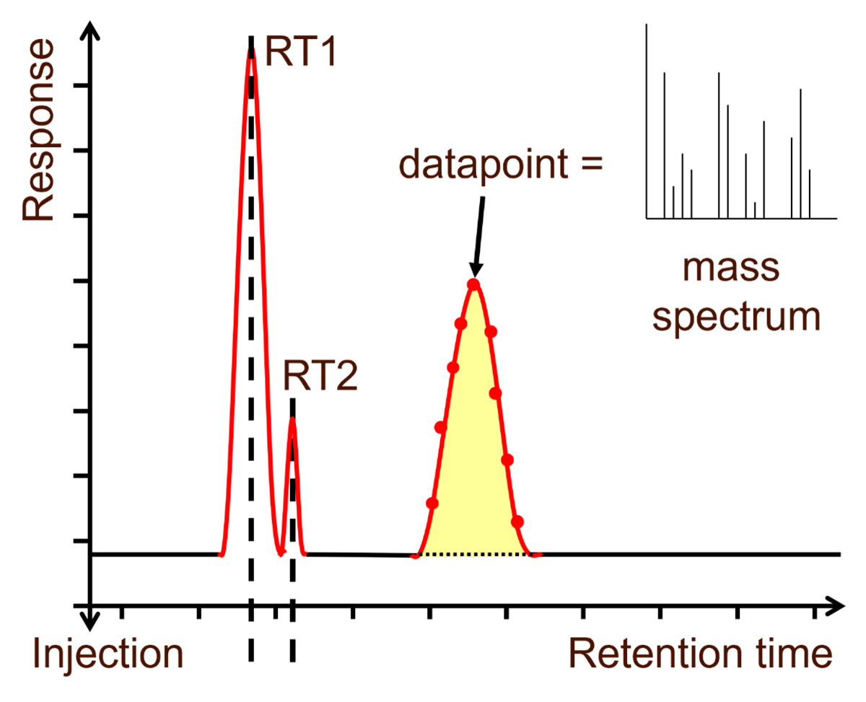
Background
Reservoir Oil Viscosity Estimation – Available technologies
Offline Technologies
Downhole PVT samples – Ground true answer
Concent. ppm
Real–time Tech. using mud gas logging
Advanced Mud gas: C₁ to C₅
Standard Mud gas: C₁ to C₃
Traditional Geochem GC-MS
Analysis with size exclusion liq. chromatography
Short lead-time Tech. Using cutting extracts
Reservoir Oil

Slide 4
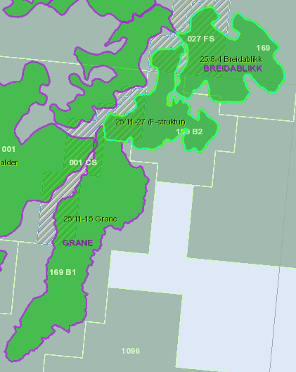
Breidablikk Field Description
Located in the Norwegian Continental Shelf (NCS)
Jointly developed by Equinor (operator), Vår Energi, Petoro and ConocoPhillips
Total recoverable oil reserves of about 30 million standard cubic meters (MSm³)
The main reservoir is distributed among two structures, F and D
3 exploration wells and 26 production wells planned
The reservoir oil is biodegraded with viscosities ranging from 4 cP to 10 cP

Slide 5
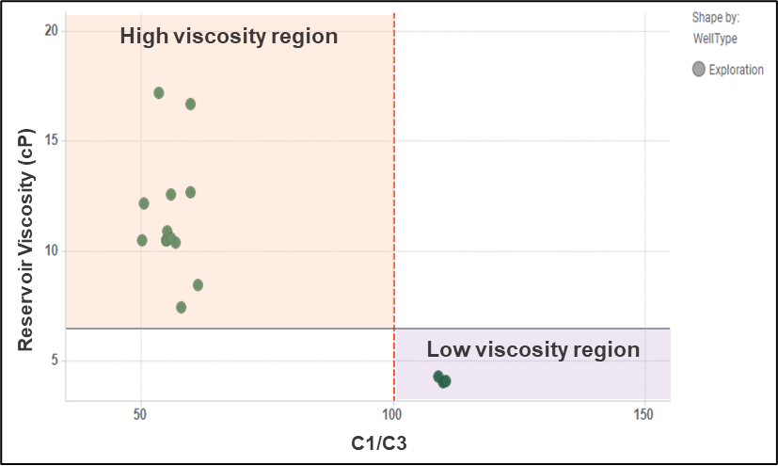
Viscosity estimation from mud gas logging
Standard mud gas
OBM drilling system
Degasser Temp. conditions: Not controlled, ~ 20°C
Temperature Correction based on an EOS, applied to C1 to C3 components
Qualitative indicator of reservoir fluid Viscosity from PVT database: C1/C3 ratio
C₁/C₃ ratio
Oil Viscosity indicator
High Viscosity
Region > 6.5 Cp
C1/C3 < 100
Low Viscosity
Region < 6.5 cP
C1/C3 > 100
PVT database
Grane-Breidablikk
Preliminary threshold
C₁/C₃ ratio = 100
Breidablikk wells for viscosity evaluation
Well | C₁ | C₂ | C₃ | C₁/C₃ | Mud type | Viscosity (cp)
1 | 92.4 | 6.7 | 0.8 | 109 | OBM | 4.0
2 | 91.2 | 7.2 | 1.5 | 61 | OBM | 8.1
3 | 92.8 | 6.3 | 0.9 | 107 | OBM | 6.2
4 | 91.7 | 6.4 | 0.9 | 104 | OBM | 10.1
Well | C₁ | C₂ | C₃ | Mud type | Viscosity (cp)
1 | 92.4 | 6.7 | 0.8 | OBM | 4.0
2 | 91.2 | 7.2 | 1.5 | OBM | 8.1
3 | 92.8 | 6.3 | 0.9 | OBM | 6.2
4 | 91.7 | 6.4 | 0.9 | OBM | 10.1
C1/C3 ratio PVT samples

Slide 6
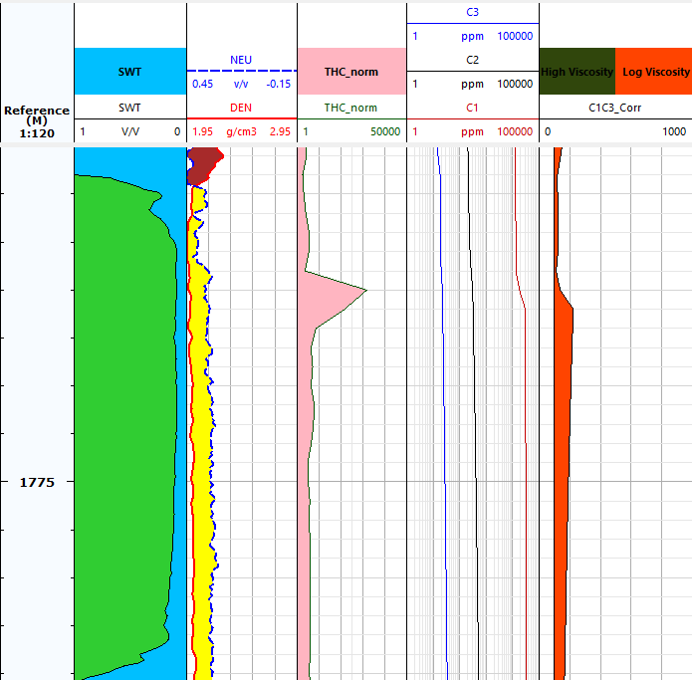
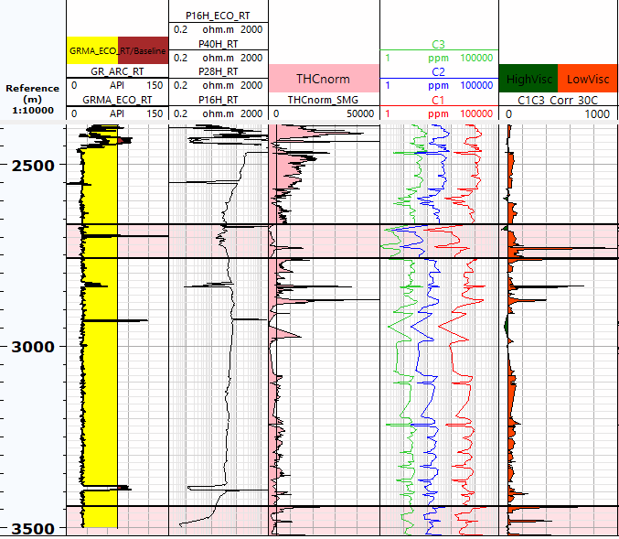
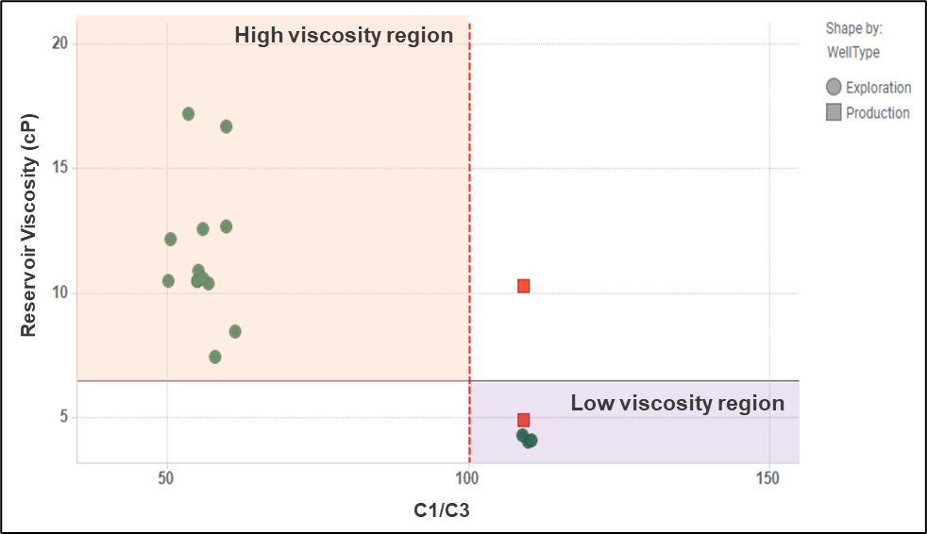
Viscosity estimation from mud gas logging
Standard mud gas – Production wells
Well 3
C1/C3 ratio PVT samples – Breidablikk data points exploration and prod. plotted
Well 1
Inconclusive
C₁/C₃ ratio from standard mud gas is unsuitable to qualitative indicate reservoir oil viscosity in Breidablikk

Slide 7
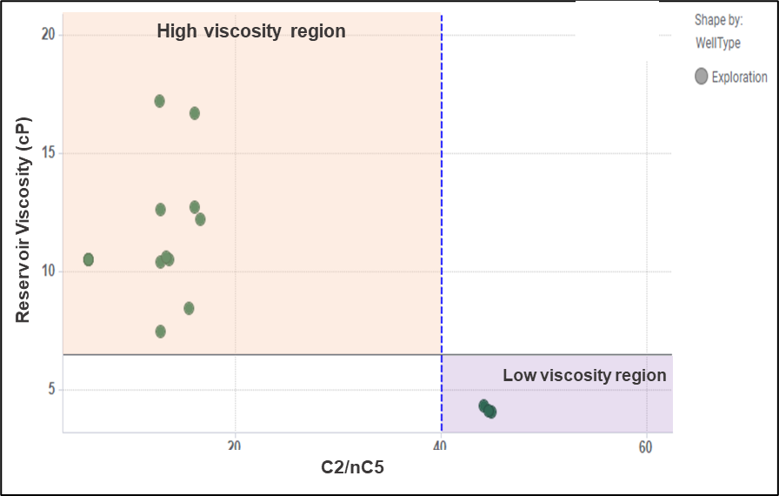
Viscosity estimation from mud gas logging
Advanced mud gas
OBM drilling system
Degasser Temp. conditions: Controlled, ~ 90 °C
C₁ to C₅ components
Qualitative indicator of reservoir fluid Viscosity from PVT database: C₂/nC₅ ratio
C₂/nC₅ ratio
Oil Viscosity indicator
High Viscosity
Region > 6.5 cP
Low Viscosity
Region < 6.5 cP
PVT database
Grane-Breidablikk
Breidablikk wells for viscosity evaluation
Well | C₁ | C₂ | C₃ | C₄ | C₅ | Mud type | Viscosity (cp)
1 | 89.0 | 6.4 | 0.8 | 3.0 | 0.90 | OBM | 4.0
2 | 86.3 | 6.8 | 1.4 | 3.6 | 1.8 | OBM | 8.1
3 | 89.4 | 6.0 | 0.9 | 2.6 | 0.9 | OBM | 6.2
4 | 85.6 | 5.9 | 0.8 | 4.3 | 3.3 | OBM | 10.1
Preliminary threshold = 40
Well | C₁ | C₂ | C₃ | C₄ | C₅ | C₂/nC₅ | Mud type | Viscosity (cp)
1 | 89.0 | 6.4 | 0.8 | 3.0 | 0.9 | 45 | OBM | 4.0
2 | 86.3 | 6.8 | 1.4 | 3.6 | 1.8 | 15 | OBM | 8.1
3 | 89.4 | 6.0 | 0.9 | 2.6 | 0.9 | 41 | OBM | 6.2
4 | 85.6 | 5.9 | 0.8 | 4.3 | 3.3 | 19 | OBM | 10.1
C2/nC5 ratio PVT samples

Slide 8
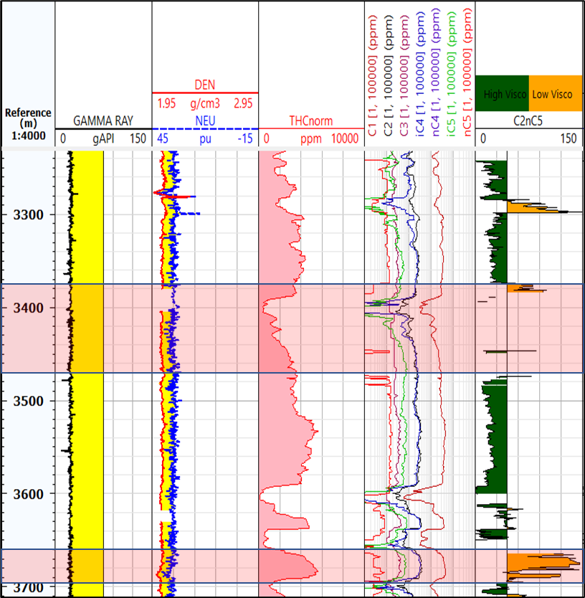
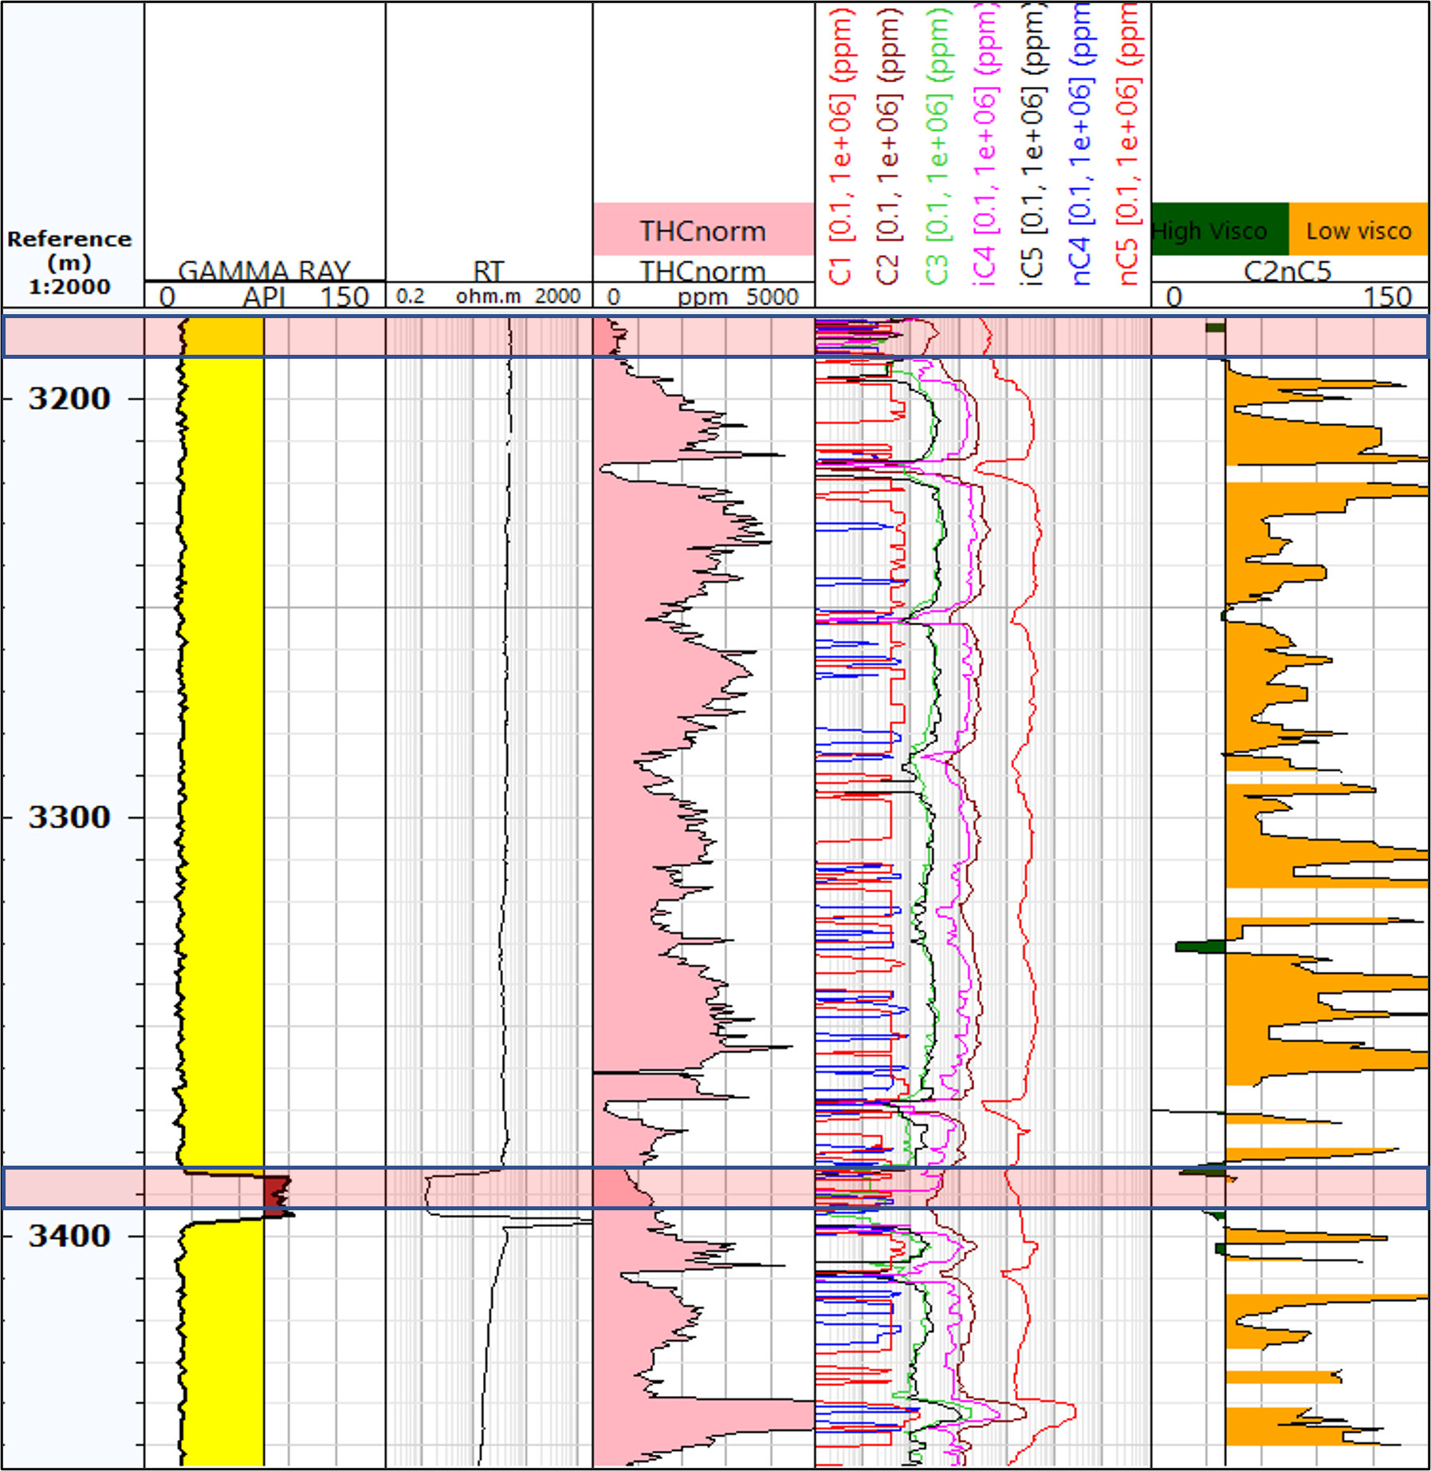
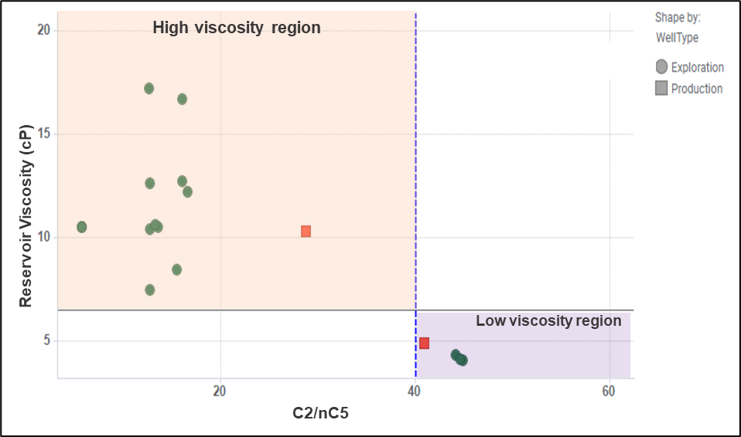
Viscosity estimation from mud gas logging
Advanced mud gas – Production wells
C2/nC5 ratio PVT samples – Breidablikk data points exploration and prod. plotted
Well 3
Well 4
C₂/nC₅ ratio from advanced mud gas is an adequate parameter to qualitative indicate reservoir oil viscosity in Breidablikk

Slide 9
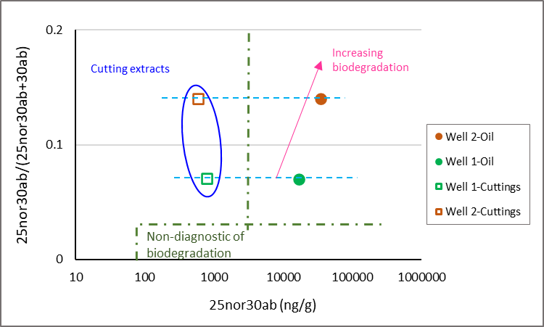
Viscosity estimation from cuttings extracts analysis
Demethylated hopane biomarker ratio from reservoir oil samples vs. reservoir oil viscosity for Breidablikk
Based on a conventional geochemical analytical program:
bulk composition
Gas Chromatography (GC)
Gas Chromatography-Mass Spectrometry (GC-MS)
Dilution effect on the demethylated hopanes concentration in cuttings wrt. biomarker concentration in reservoir oils

Slide 10
Viscosity estimation from cuttings extracts analysis
OBM no emulsifying additives ROP < 30 m/h | High Quality cutting
Cutting extracts quality
Plays a significant role in the successful application of this methodology
Directly impacts the quantity of extractable organic matter (EOM) present in the cutting extracts
OBM w/emulsifying additives ROP < 30 m/h | Compromised quality cutting
Indication of significant entrapment of drilling mud
Exceedingly low preservation of the chunk rock fragments
OBM w/emulsifying additives ROP > 70 m/h | Bad quality cutting

Slide 11
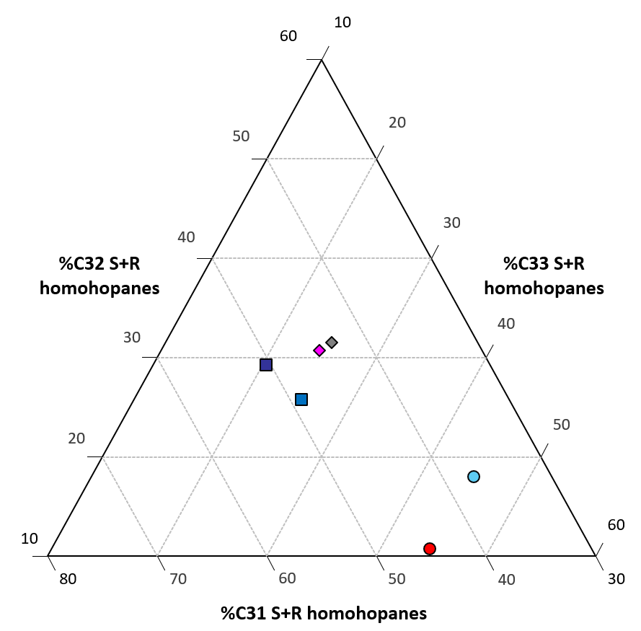
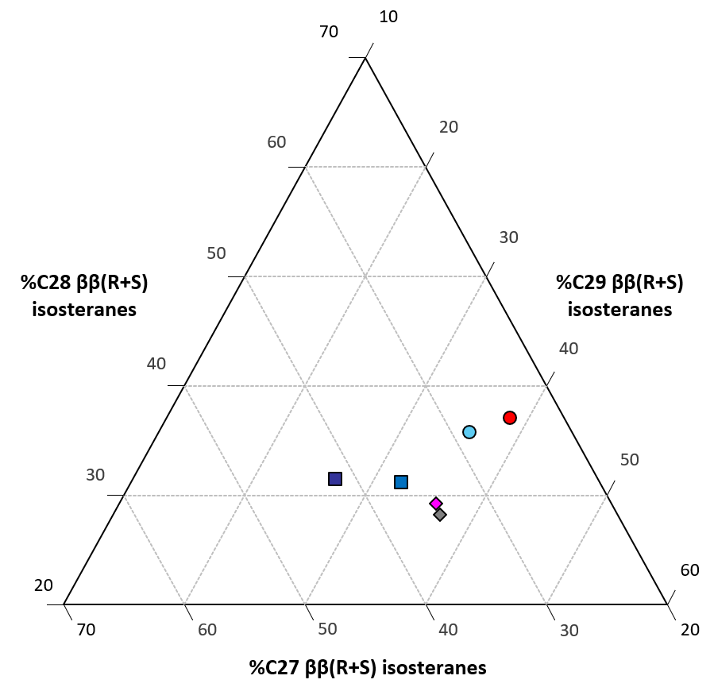
Viscosity estimation from cuttings extracts analysis
OBM
Well 3 - cuttings 1
Well 4 - cuttings 1
Well 4 - cuttings 2
Well 4 - oil
Well 3 - oil
OBM
Well 3 - cuttings 1
Well 4 - cuttings 1
Well 4 - cuttings 2
Well 4 - oil
Well 3 - oil
Cutting extracts analysis using conventional geochemical techniques is not a suitable to indicate reservoir oil viscosity in Breidablikk
Ternary plots - Sterane and hopane distribution data from the OBM, reservoir oils and cutting extracts

Slide 12
Conclusions
The reservoir oil viscosity in the Breidablikk field was estimated using a combination of:
Standard and advanced mud gas logging
Classical geochemical analysis on cutting extracts and reservoir oils
Standard mud gas logging could not effectively differentiate between the two viscosity regions. Therefore it is not suitable for qualitative estimation of reservoir fluid viscosity
The use of cutting extract analysis with traditional geochemical techniques was found to be challenging and highly dependent on the quality of the cuttings.
Therefore, this method is not recommended for estimating the reservoir oil viscosity in the Breidablikk field
Advanced mud gas logging provides a real-time qualitative indication of the reservoir oil viscosity in Breidablikk field
C2/nC5 hydrocarbon ratio, with a threshold of 40 between the high and low viscosity regions, is selected for viscosity estimation

Slide 13
Acknowledgments
The authors thank Equinor ASA, Vår Energi, Petoro, and ConocoPhillips management for permission to publish this paper. Sincere thanks to the Breidablikk asset subsurface team for the fruitful discussions. The support from Equinor’s Technology, Digital and Innovation (TDI) business area, especially from Vibeke Haugen, Monica Vik Constable, Peter Eilsø Nielsen, and Tore Vikaunet is much appreciated. Special thanks go to Equinor's Exploration and Production International (EPI) business area management, especially from Ingrid Hauge and Jarle Larsen.

Slide 14
Holistic Evaluation of Reservoir Oil Viscosity in Breidablikk Field – Including Mud Gas Logging Approach - SPWLA-2023-0039 Alexandra Cely, Ingvar Skaar and Tao Yang Equinor ASA
Norwegian Formation Evaluation Society
Monthly Meeting @ Solastranden Gård, Sola
7th February 2024
Sponsors

